Slide 1
Hourly Supervisor Training

Slide 2

Policy: Hours
Southern Utah University does not allow hourly employees to work over 1,500 hours over the course of 12 months.
The hours are counted in a “Rolling” 12 month fashion:
  Each month, the most recent month is added and the oldest month is removed.
  For example in August 2019 we look at hours from August 2018 through July 2019.
  In September 2019 we will look at hours from September 2018 through August 2019.
If an hourly employee reaches 1500 hours they must be offered benefits or terminated.

Slide 3
Procedure: Hours
To follow policy, SUU has put in place the following procedures:
  Hourly students are allowed to work 20 hours per week on average during the school year and 40 hours per week during summer and breaks (Christmas, spring break, etc)
  Hourly non-students have the option to work 29 hours per week on average throughout the full year or to work 20 hours per week during the school year and 40 hours per week during the summer and breaks.
  Hourly employees are allowed to have no more than 2 jobs on campus at the same time (some exceptions apply).
  Supervisors are to monitor their employees’ hours so that they do not go over the 1500 hours.

Slide 4
HR emails for hour warnings
As of August 5, 2019:
  2 employees had over 1500 hours; 3 had over 1400; 16 had over 1300; and 24 had over 1200.
HR will be sending an email when an employee has worked over 1200 hours within the last 12 months. This is a reminder to monitor your employees’ hours so that they don’t get above the 1500 hours. This doesn’t mean they have to be terminated, but is a reminder to monitor your employees’ hours.

Slide 5

Employee Survey Information
A survey was completed by hourly employees from fiscal year 2017, of which 236 completed the survey. The following information was discovered:
  9.5% were instructed by their supervisor to report LESS hours than they actually worked.
  6.3% were instructed by their supervisor to report MORE hours than they actually worked.
  Other respondents reported rolling hours to other weeks so that they didn’t go over (25 hours worked, report 20. Then 15 hours worked, report 20)
Please remember, employees need to report the hours they actually work in the week they work them.

Slide 6

Required Trainings for Hourly
Employees
Title IX
Sexual Harassment
FERPA if handling confidential information
It is the responsibility of the supervisor to ensure all of their team members are up to date on their trainings!
Trainings need to be completed in the first month of employment!

Slide 7

ADA

Slide 8
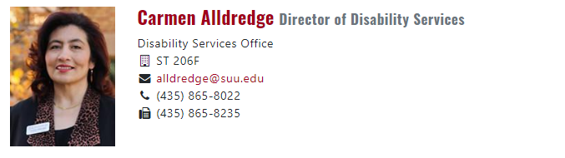
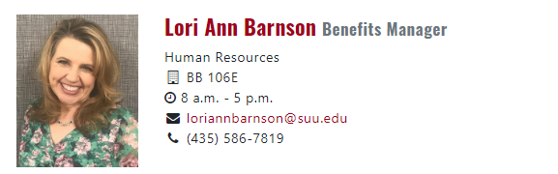
Education vs. Employment

Slide 9
Document all requests (common language or formal)!
What are the essential functions of the job?

Slide 10
Reasonable Accommodation
Any request to alter work or work environment is a request for accommodation
Does not cause undue hardship
Document everything!
Does not have to be exactly what the employee requests
Any interaction with a doctor goes through HR. Once the doctor is involved, there must be an interactive process.

Slide 11
Benefits of providing Reasonable Accommodations
Loyal Employees
Capable Employees
Happy Employees

Slide 12
T-Bird Campus Jobs

Slide 13
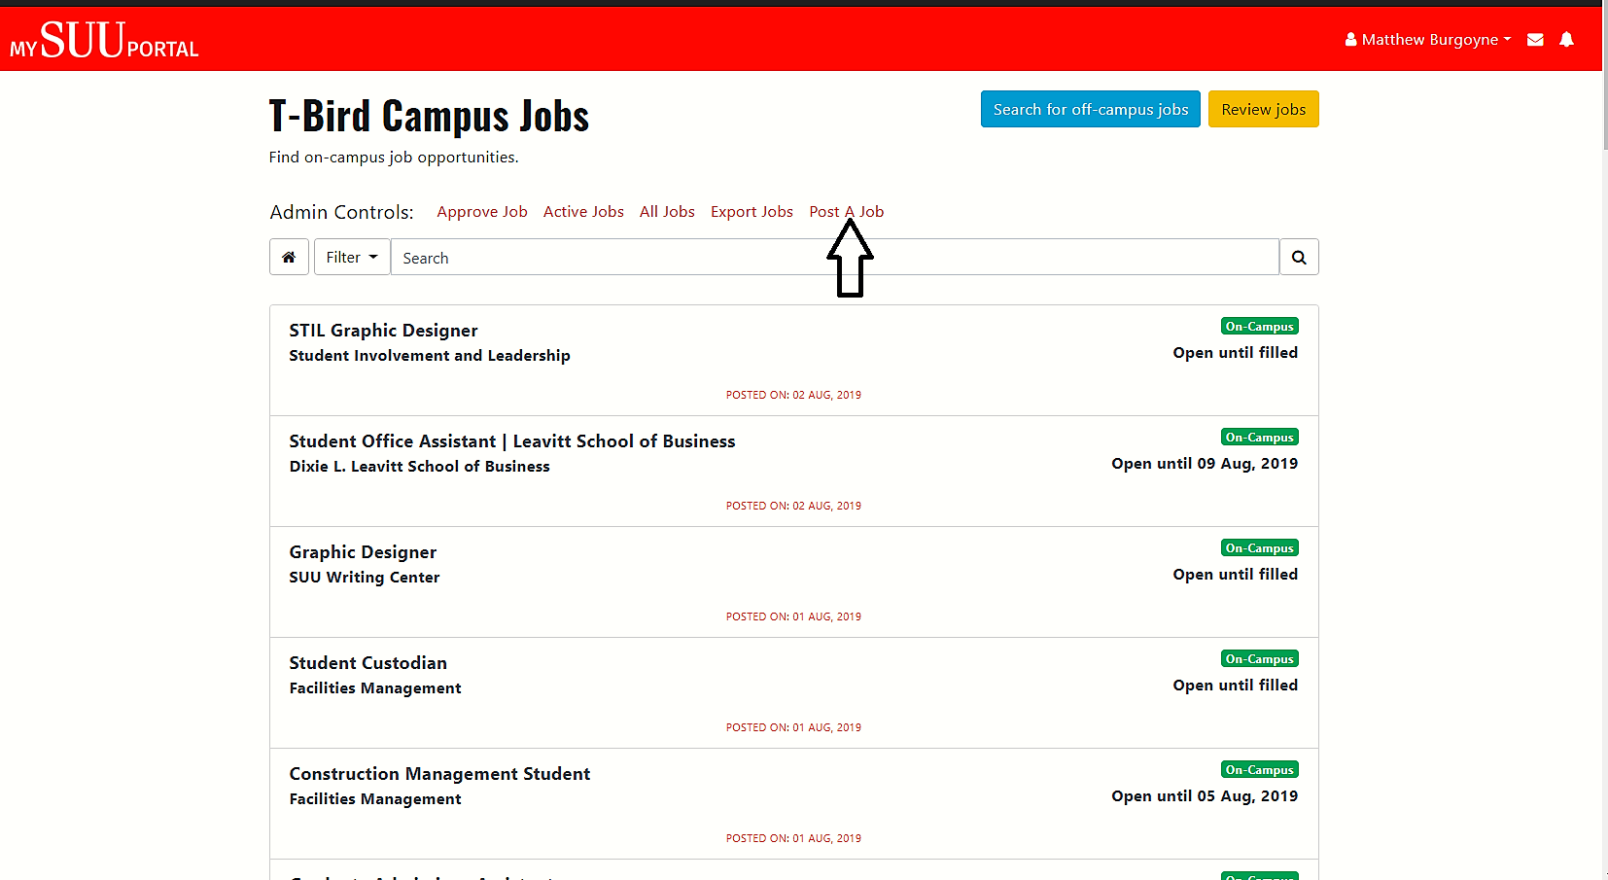

Slide 14
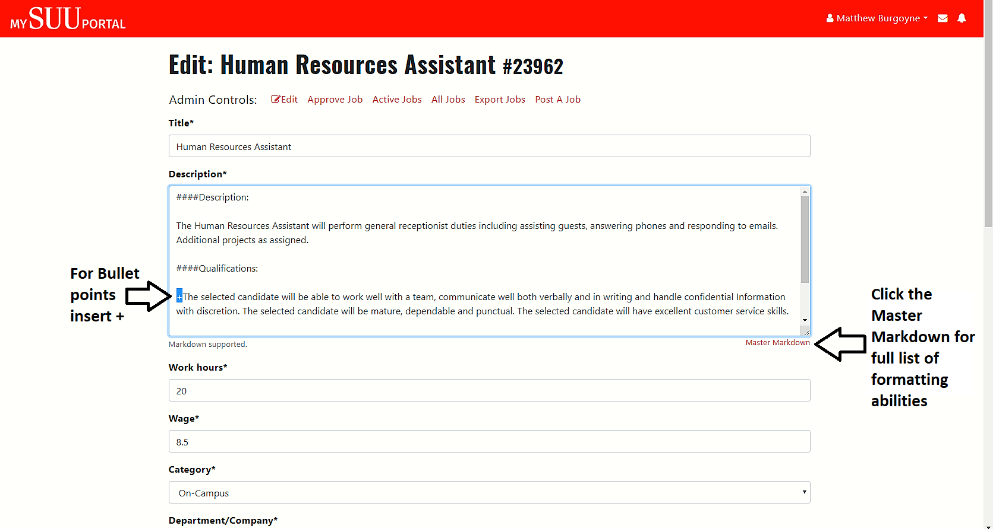

Slide 15
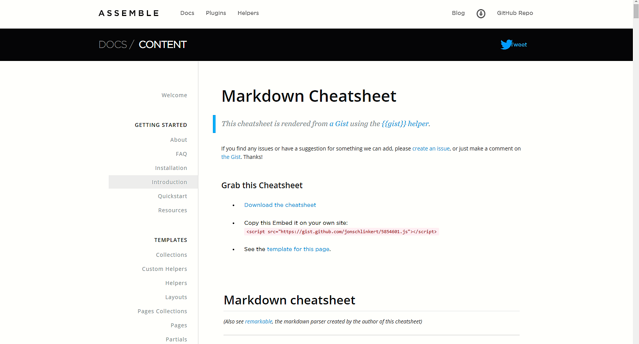

Slide 16
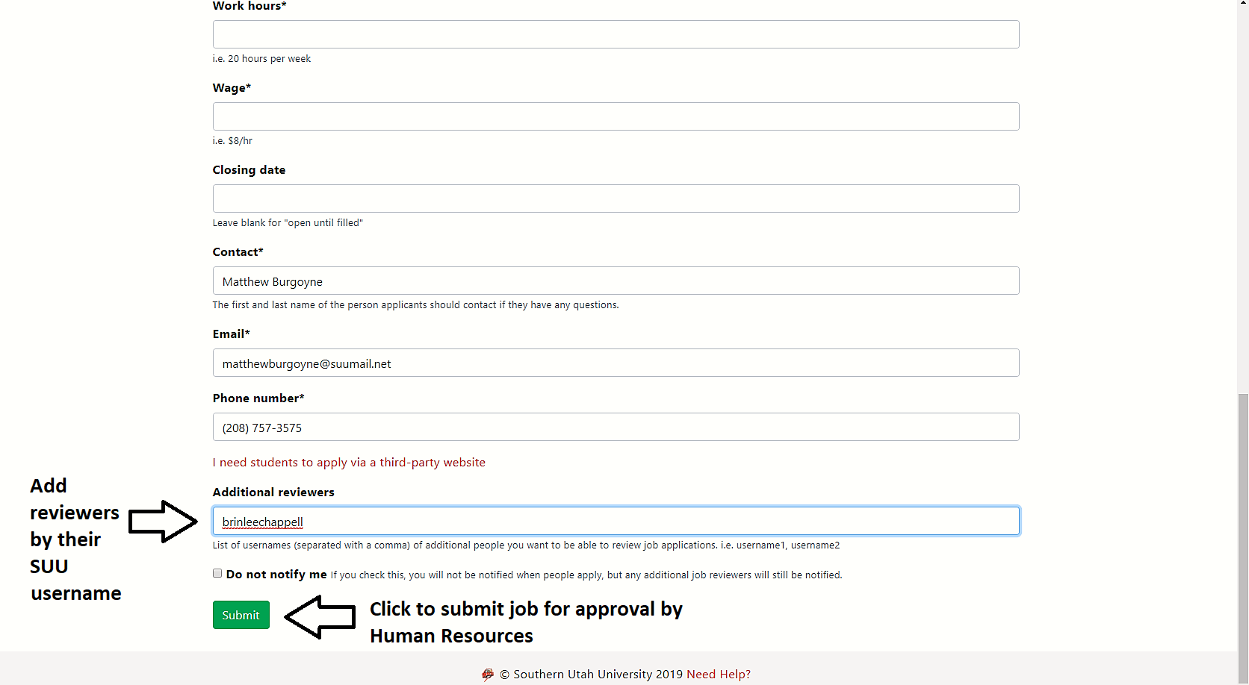

Slide 17
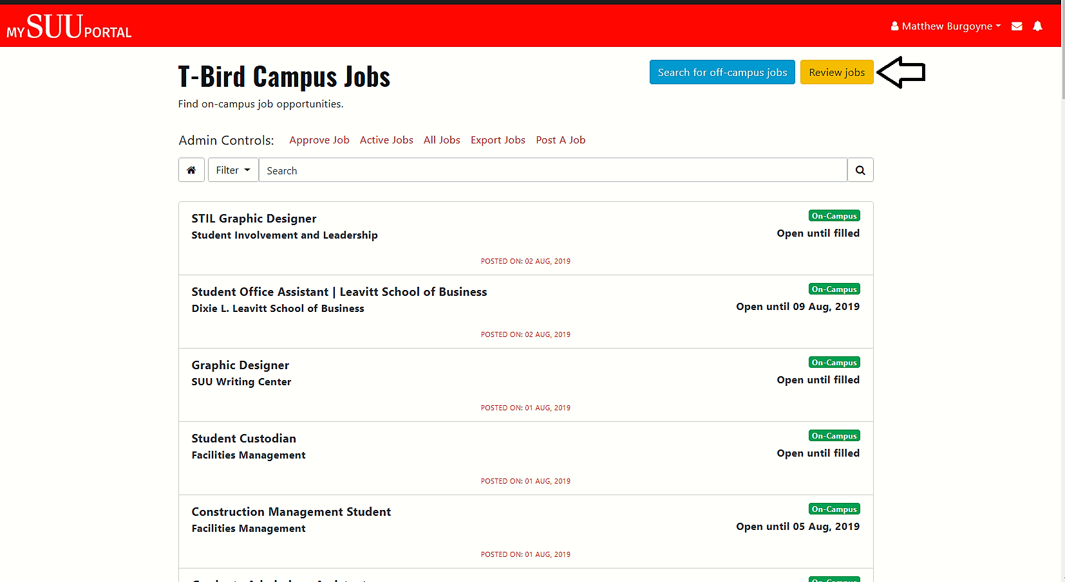

Slide 18
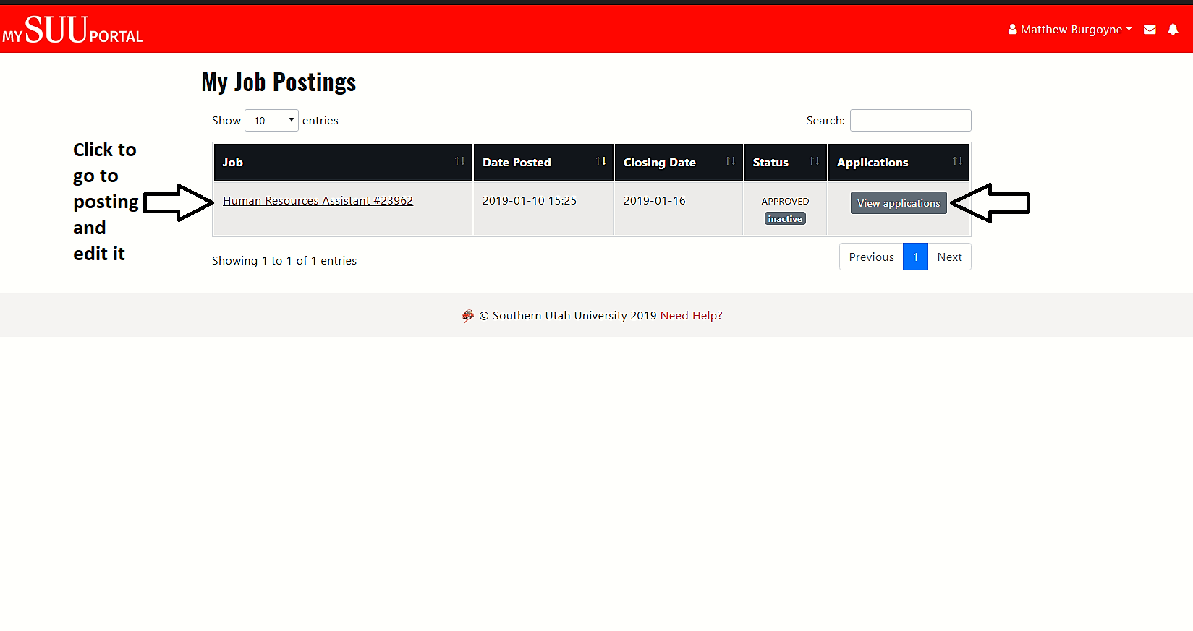

Slide 19
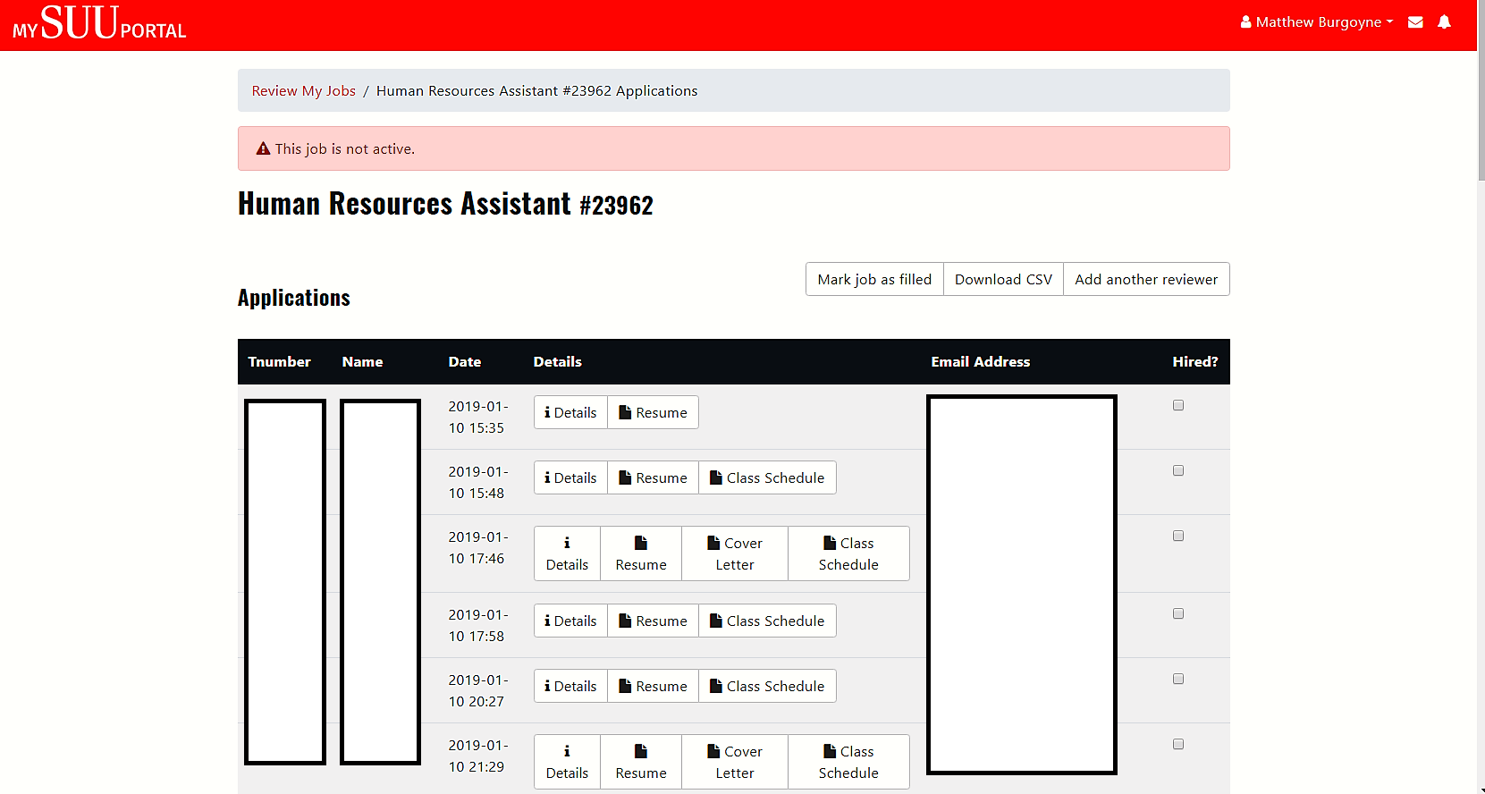

Slide 20
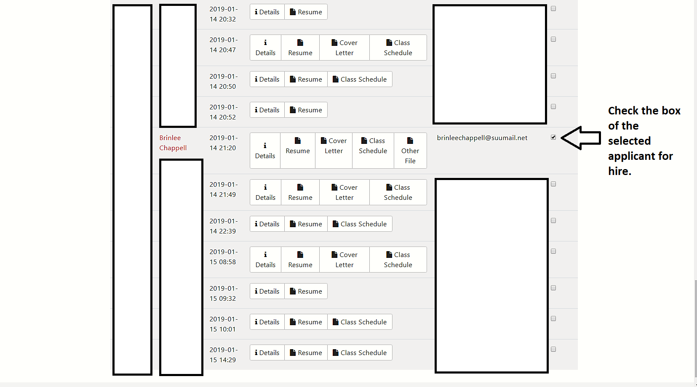

Slide 21
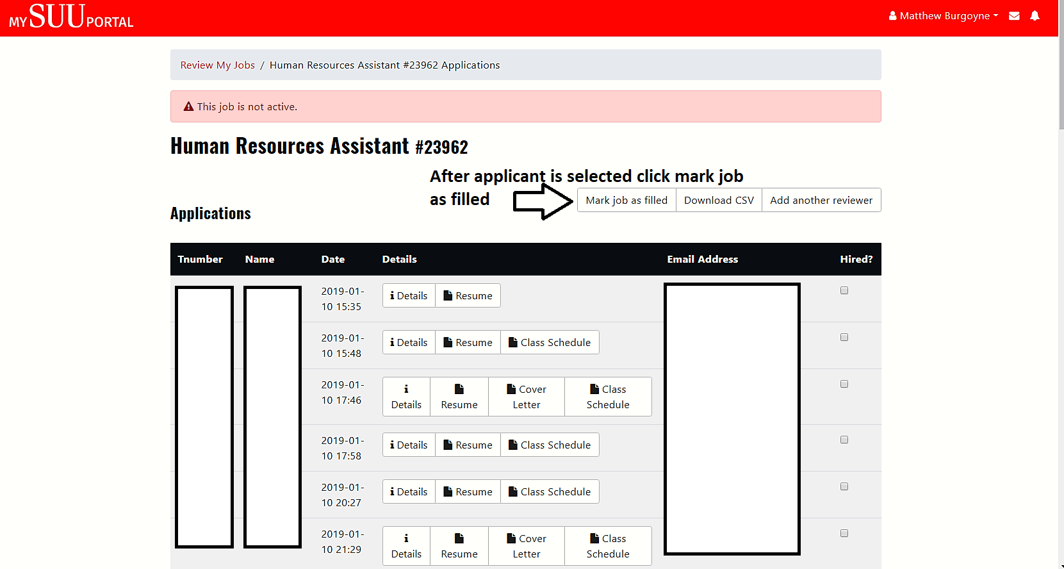

Slide 22
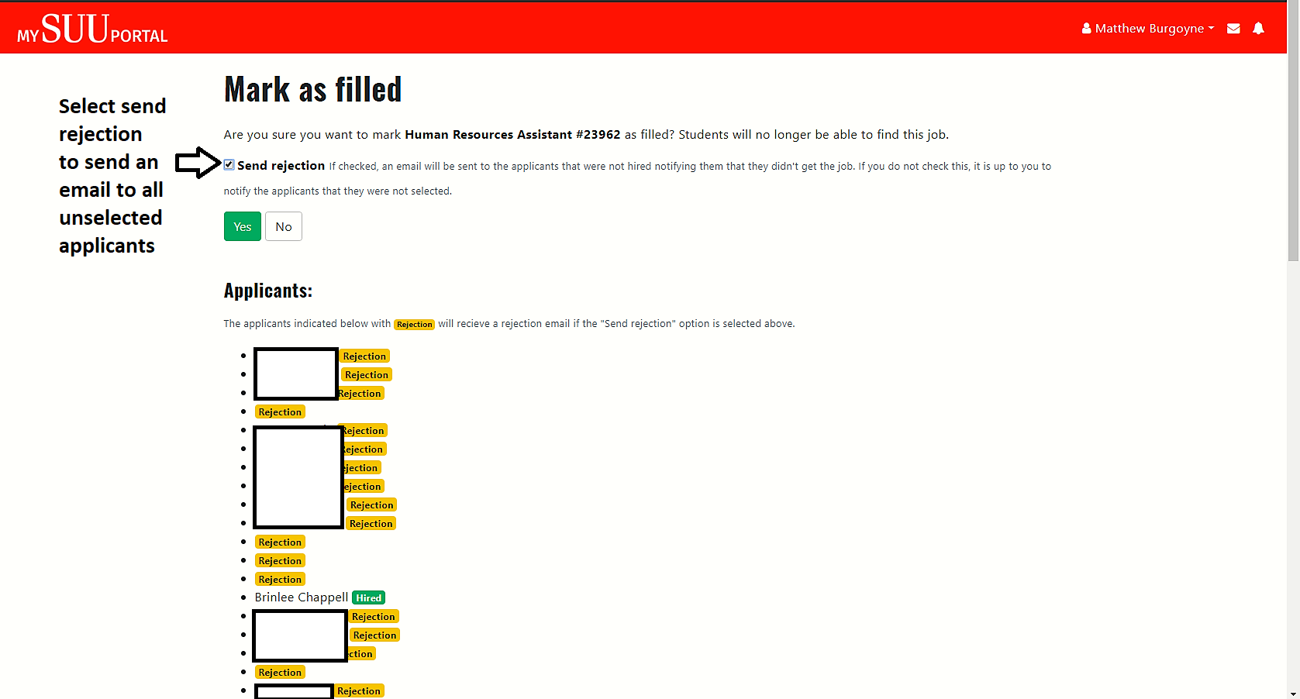

Slide 23
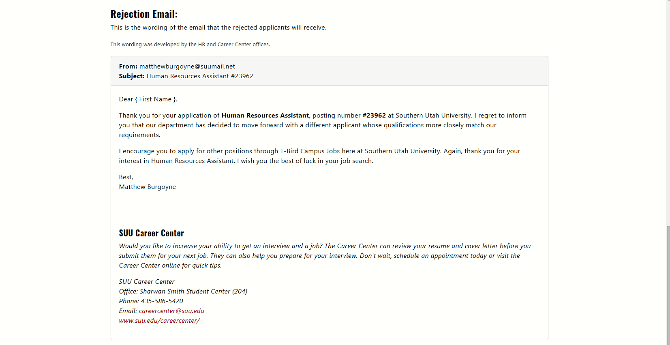

Slide 24
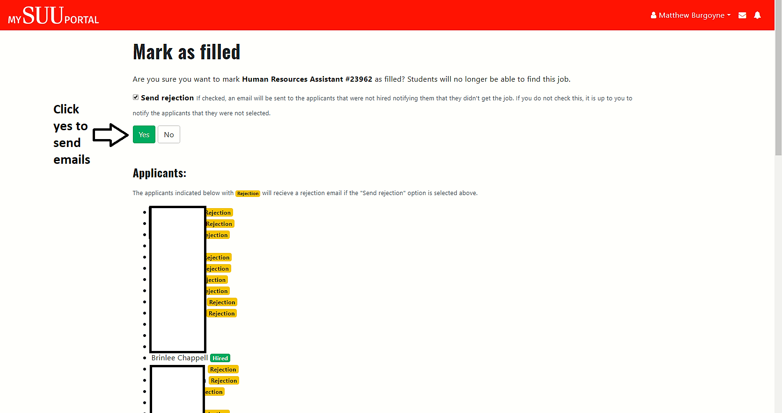

Slide 25
Onboarding Process

Slide 26
Starting Employees
If employee has worked on Campus within the last year:
  They do not need to come to the HR office.
  Submit an EPAF for their new position
If the employee is new or hasn’t worked within the last year:
  They need to come to the HR office with the appropriate forms of ID.
  If the employee already has a T-number:
    You can submit an EPAF immediately.
  If they do not have a T-number:
    We will need to create one for them. Wait to submit an EPAF until we send you their T-number.
  Unless we have an EPAF for the employee in our queue, we will send you an email requesting an EPAF for the employee after they have completed their paperwork.

Slide 27
International Students
Social Security Number
  Visit International Affairs
  Go to Social Security Office
  Come to HR with:
    Passport
    Copy of I-94
    Receipt from the Social Security office
  They can start their paperwork once they have the receipt, but cannot start their position until they receive their social security number. This can take up to two weeks.

Slide 28
Automated Emails
Paperwork Notification Email
  Sent to all employees except those that have worked within the last year.
  Sent once the EPAF has been created
Submitting Time and Direct Deposit
  Sent to all employees once the job has been applied.
**If you have to submit a second hourly hire, they will be emailed again.

Slide 29
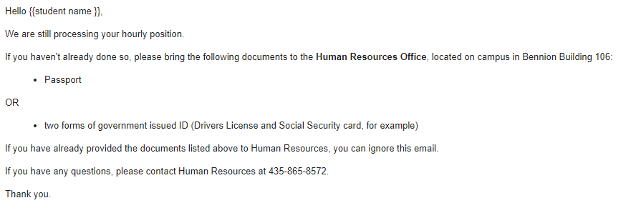
Paperwork notification email sent to employee when the epaf is submitted (if they haven’t worked in the last year):

Slide 30
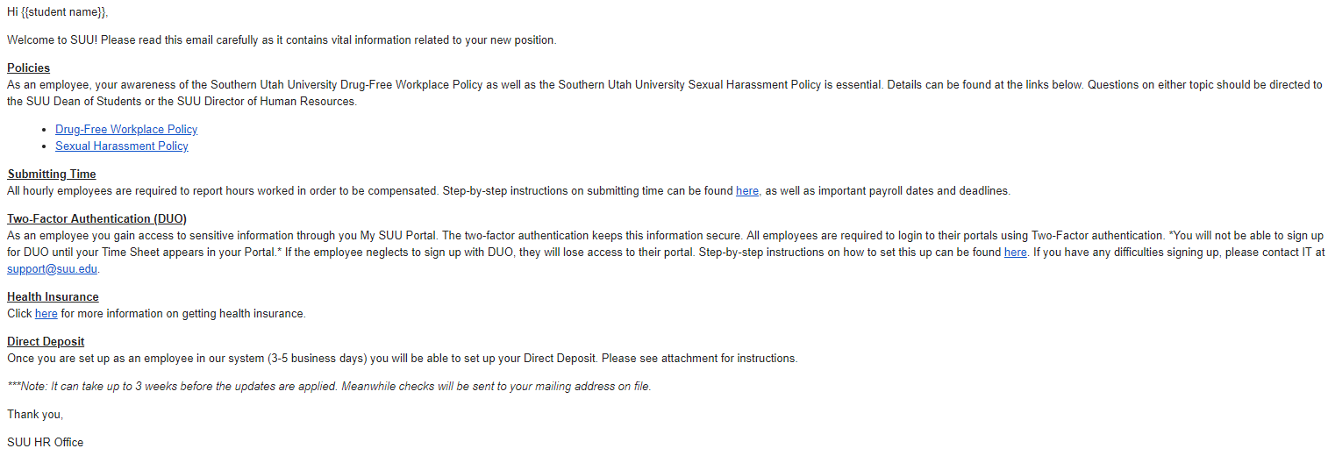
Email sent to employee when epaf is approved:

