Slide 1
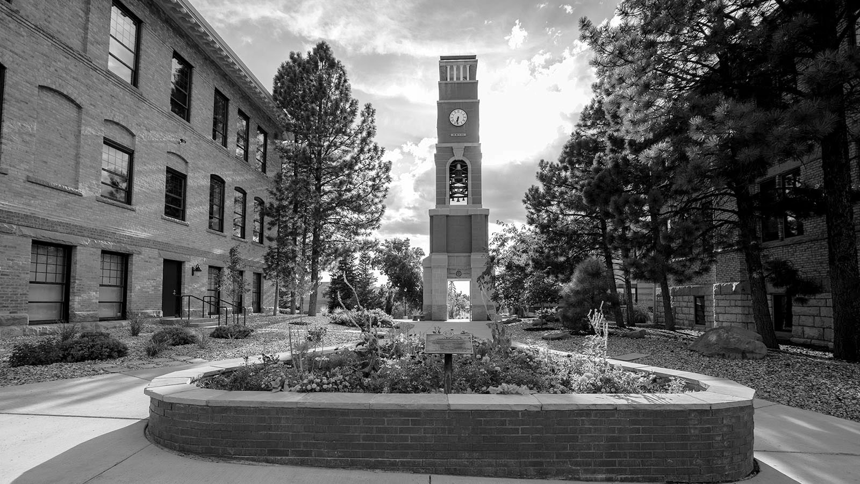
Purchasing Training
Southern Utah University

Slide 2
Purchasing Contacts
Brad Brown - Director of Purchasing
586-7871 brown@suu.edu
Dan Camp - Purchasing Agent
586-7732 camp@suu.edu
Marisa Foster - Administrative Assistant
586-7717 fosterm@suu.edu
Kennedy Cowan - Purchasing Coordinator
586-7733 kennedycowan@suu.edu

Slide 3
General Purchasing

Slide 4
Policy and Procedures
State of Utah Procurement and SUU Policy determine the rules, regulations, and order for our university
The university has an extensive policy regarding the purchasing of goods and services. The Purchasing Office is here to help you and your department be in compliance with policy and to help with the procedures required
A copy of the policy is available at the Purchasing Office or online at www.suu.edu/ad/purchasing/policies.html

Slide 5
Placing Orders
Only purchasing office personnel are authorized to sign agreements that involve university funds
No employee may ever authorize, place, approve, agree, promise, or order any item without prior approval through the use of a
Purchase Order
Purchasing Card
The only personnel authorized to sign contracts are Brad Brown, Marvin Dodge, and President Wyatt

Slide 6
Purchasing Cards
University owned Visa credit cards for employees normal day-to-day requirements and other special needs
Contact Kennedy with any questions/concerns

Slide 7
Purchasing Card Processes
Forms
To receive a new purchasing card
Submit to Kennedy a filled Purchasing Card Application that is signed by the account manager and supervisor
When the card arrives, the cardholder will go through training with Kennedy
To adjust a purchasing card (allow 24 hrs)
Fill out an Adjustment Request Form
Have the account manager sign the form
If the request is for restaurants to be open on the card, the VP, Dean, or President needs to sign off on the form
Send that form to Kennedy
Monthly limits start over between the 10th and 12th of every month
Important forms include
Purchasing Card Application
Purchasing Card Guide
Business Meal Form
Flower Form

Slide 8
Purchasing Card Policies and Procedures
Standard Limits
$1,000 per transaction
$5,000 monthly
Tax Exempt in Utah
Hotels are NOT tax exempt
Use anywhere that accepts Visa
NOT on SUU’s Campus - Index code instead
Post Office is exception
The cardholder is personally liable for all transactions
Only the cardholder is allowed to use the card
Use for travel
Hotel rooms, airline tickets, car rentals
NOT fuel
Purchasing food for departmental meetings, parties, or open houses for faculty/staff members must be approved by the Dean, VP, or President
All food purchases must be accompanied by Business Meal Form
Signed by Dean, VP, or President
Receipts must be itemized and include business justification for purchase
No gift cards can be purchased unless approved by President Wyatt
No personal items
Transactions above $5,000 cannot be purchased on the card (excluding travel)
Don’t purchase computers/iPads

Slide 9
Purchasing Card Dos and Don’ts
DON’T
Don’t – Let anyone else use your card
Don’t – Pay sales tax in Utah
Don’t – Use the card for personal expenses
Don’t – Use the card for meals or food unless properly authorized
Don’t – Use the card for gas, including for rental cars (use Check Requisitions for reimbursement of fuel expenses)
Don’t – Use the card on SUU’s campus (use index code for on-campus purchases)
Don’t – Split transactions to circumvent your transaction limit
Don’t – Forget the detailed/itemized receipt or documentation
Don’t – Purchase computers, including iPads, with the card (contact IT)
DO
Do – Use the card when possible instead of a PO
Do – Provide Utah sales tax exempt information to the vendor
Do – Pay for travel & conference fees (registration fees, hotels, airline tickets, checked luggage, shuttles, and taxis)
Do – Get a receipt every time you use your card
Do – Protect the purchasing card information like you would your own personal card
Do – Include the business purpose on or with each receipt

Slide 10
Purchasing Card Violations
Major Violations will result in the card being immediately frozen and/or permanently terminated
Split transactions
Missing statements
Unapproved purchases over the $5,000 bid limit
Purchases of alcohol
Giving the card to someone else
Intentionally using the card for personal purchases
Minor Violations will result in the card being frozen and/or permanently terminated if the mistake isn’t corrected within one month following the audit in which they are discovered/reported
Missing receipts
Non-itemized receipts
Missing or unapproved Meal Form
Accidental personal purchase
Missing Business purpose with the receipt

Slide 11
Roles of the Account Manager and Supervisor
A cardholder CANNOT approve of anything for their own card
Email Kennedy if you are unsure who acts as the account manager (usually admin assistant) and supervisor (usually director or department chair) for your department
All Purchasing Card Adjustment Request Forms need to be signed by the account manager or supervisor
Adjustments for the account manager need to be signed by the supervisor/Dean/VP
Account Managers will go through the quarterly audit for their department
Individual cardholders are responsible for having their receipts, meal forms, and statements
Supervisors must approve of all statements before the audit

Slide 12
Requisitions and Purchase Orders
Contact Marisa with any questions regarding online requisitions or purchase orders

Slide 13
Purchase Order Types
Regular Purchase Order
Purchase orders used for most purchases (represents a contract) that will either be mailed or emailed based on what the department requests
Standing Purchase Order
A purchase order which is issued by a department to a vendor for a set amount, not exceeding $5,000 (state contract is an exception)
During the period of the standing order (1 year), the department will contact that vendor and request goods and services until the value of the standing order is complete.
Standing Purchase Orders can be decreased or increased during the year.

Slide 14
Important Terms to Know
Check With Order
If a prepayment/deposit is required
Service contract continuation

Slide 15
When to use a Check Requisition vs. a PO
Check Requisition
Reimbursement for employee expenses
Moving expenses
Professional fees
Non-employee travel reimbursement
Wire transfer
This form is an Accounts Payable form, is located in the Accounts Payable office
Purchase Order
Supplies
Materials
Services
Equipment
Any contractual agreement
If you are unsure which option to use, please contact the Purchasing Office

Slide 16
Purchase Thresholds
For orders $0.00-$5,000:
Bids are not required. However, prudent and competitive business practices are encouraged
Recommended that university employees compare multiple sources for pricing (in written form) of goods or services before completing a transaction
For orders *$5,001-$50,000:
A formal bid document must be prepared and administered by an authorized member of the Purchasing Office
For orders above *$50,000:
The State of Utah Purchasing Policies, procedures, and laws must be adhered to for all purchases of this level
Process time allowed for this level of transaction will be at a minimum of ten (10) working days to satisfy State of Utah code requirements.
*Note: The Purchasing Office must be contacted by the end-user prior to any contact with any vendor, person or agency

